Slide 1

Healthy Habits
By: Group 4
Jack, Hamza, Kate, Seth, Carter, Zeeshan
Notes:
Jack Taormino

Slide 2
Project Overview
Work with the DHHS to create a website
Create a game that teaches adults how to be healthy
Single, team, and multiplayer modes
Website should accept donations
Notes:
Jack Taormino

Slide 3
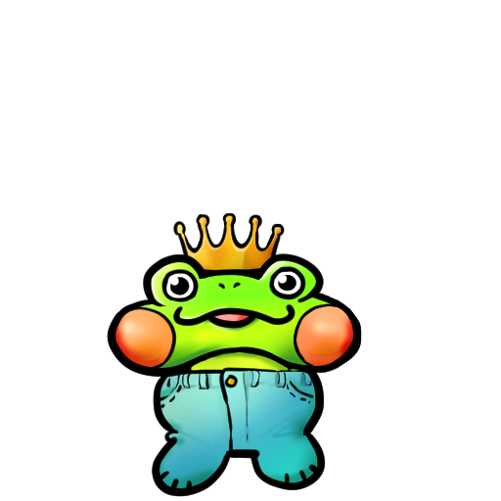
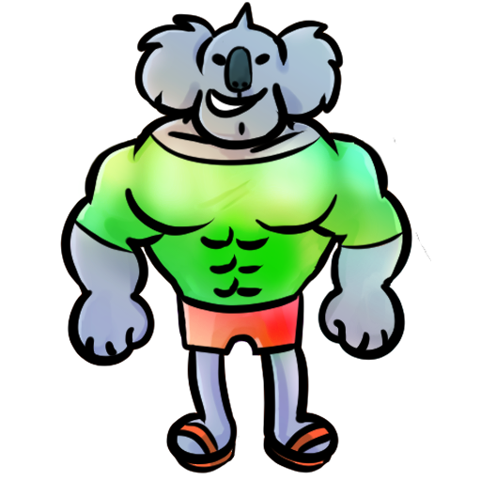

Game Objectives
User chooses a pet to take care of
Interact with other players to play trivia games in order to keep your Homiez healthy
If a player answers a question wrong your Homiez will get sad and unhealthy
Option to donate to US Department of Health and Human Services (DHHS)
Notes:
Kate

Slide 4
Game Modes
Singleplayer:
Answer health related trivia questions to keep your Homiez healthy
Multiplayer:
Show your knowledge by facing off in a 1v1 trivia battle against a friend
Co-op:
Work with a friend to answer questions and get bonus rewards
Notes:
Kate

Slide 5
Tools Used
Visual Studio Code - IDE
HTML/CSS
Javascript
Github Pull Request
Live Server
Firebase - Authentication
PayPal - Card Transactions
Namecheap.com - Domain
Heroku - Hosting
Notes:
Jack Taormino

Slide 6
Tasks
Front-End:
User Interface
Simple, easy to navigate
Pages:
Login
Main Menu
Trivia
Multiplayer Lobby
Multiplayer Trivia
Co-op Trivia
Back End:
Game Logic
Developed using Javascript
Database
Tracking progress and player experience
Notes:
Carter

Slide 7
www.healthyhabitz.me
Notes:
Hamza

Slide 8
Obstacles
Time
Working remotely
Inexperience
Notes:
Seth

Slide 9
Things to Work On
Making multiplayer and co-op modes
Create a mobile-friendly interface
Finalize database
Adding more questions
Add Homiez choice and leveling system
Notes:
Zeeshan

Slide 10
The End
Notes:
Hamza

